Slide 1
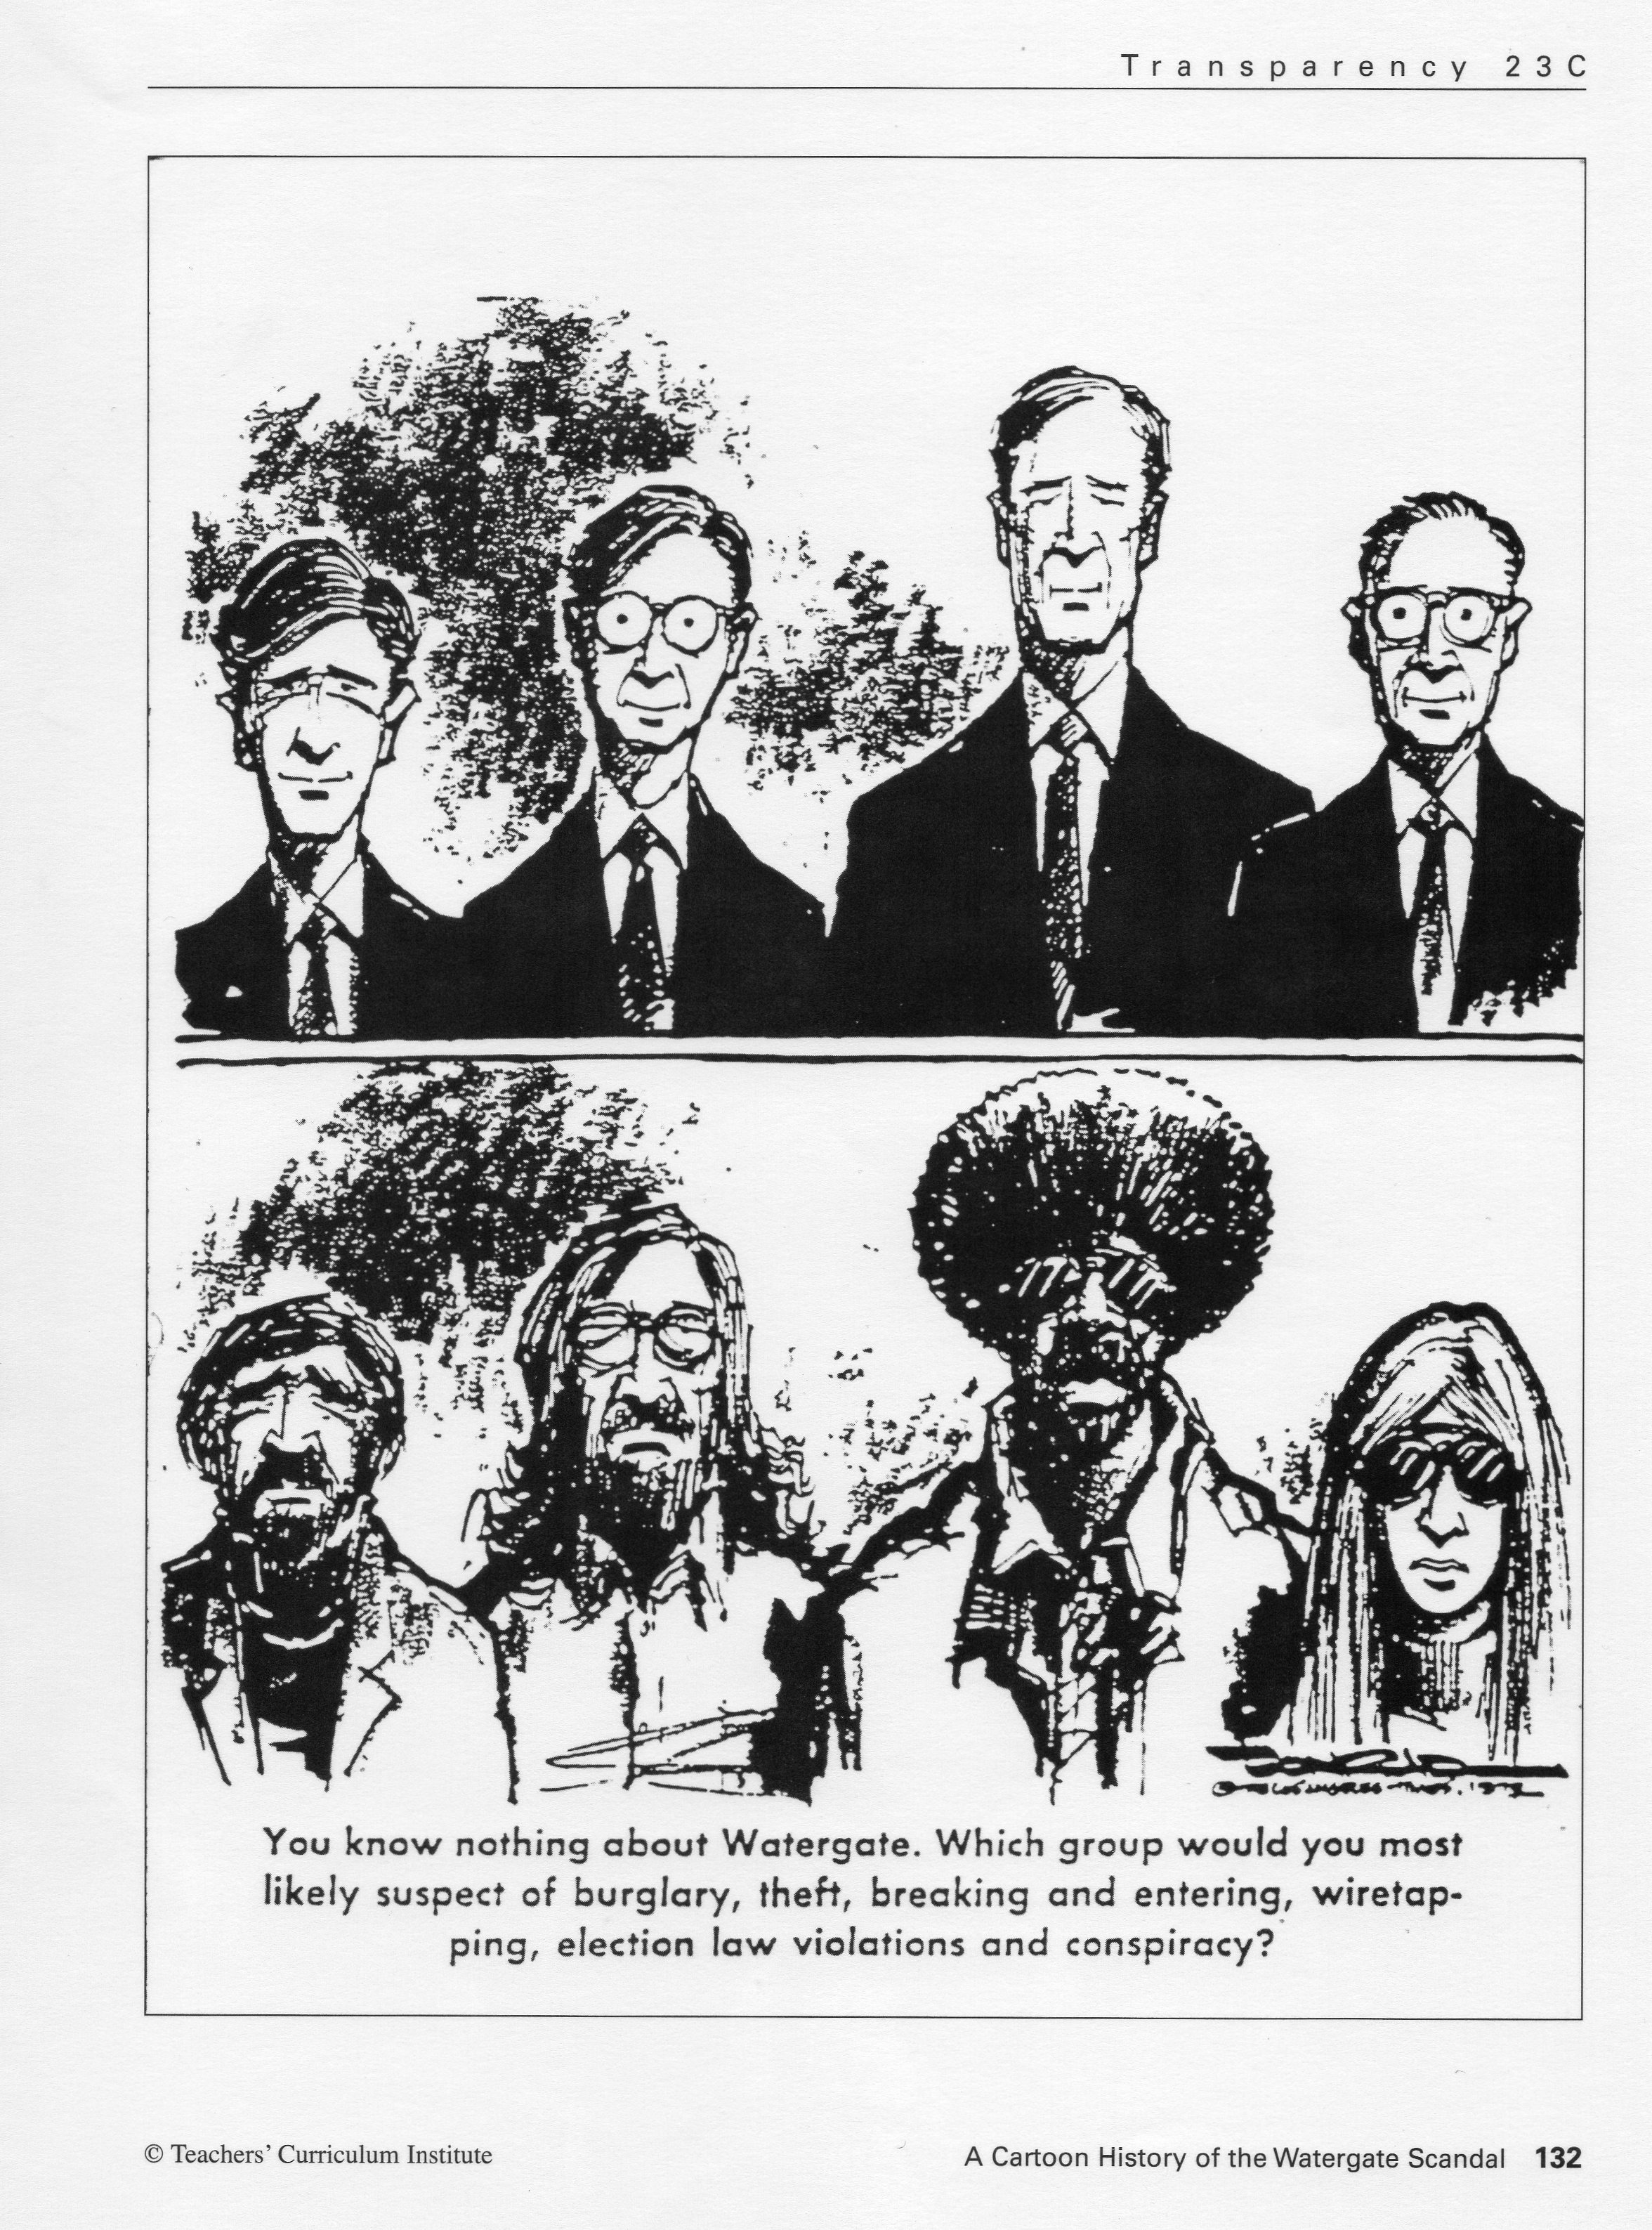

Slide 2
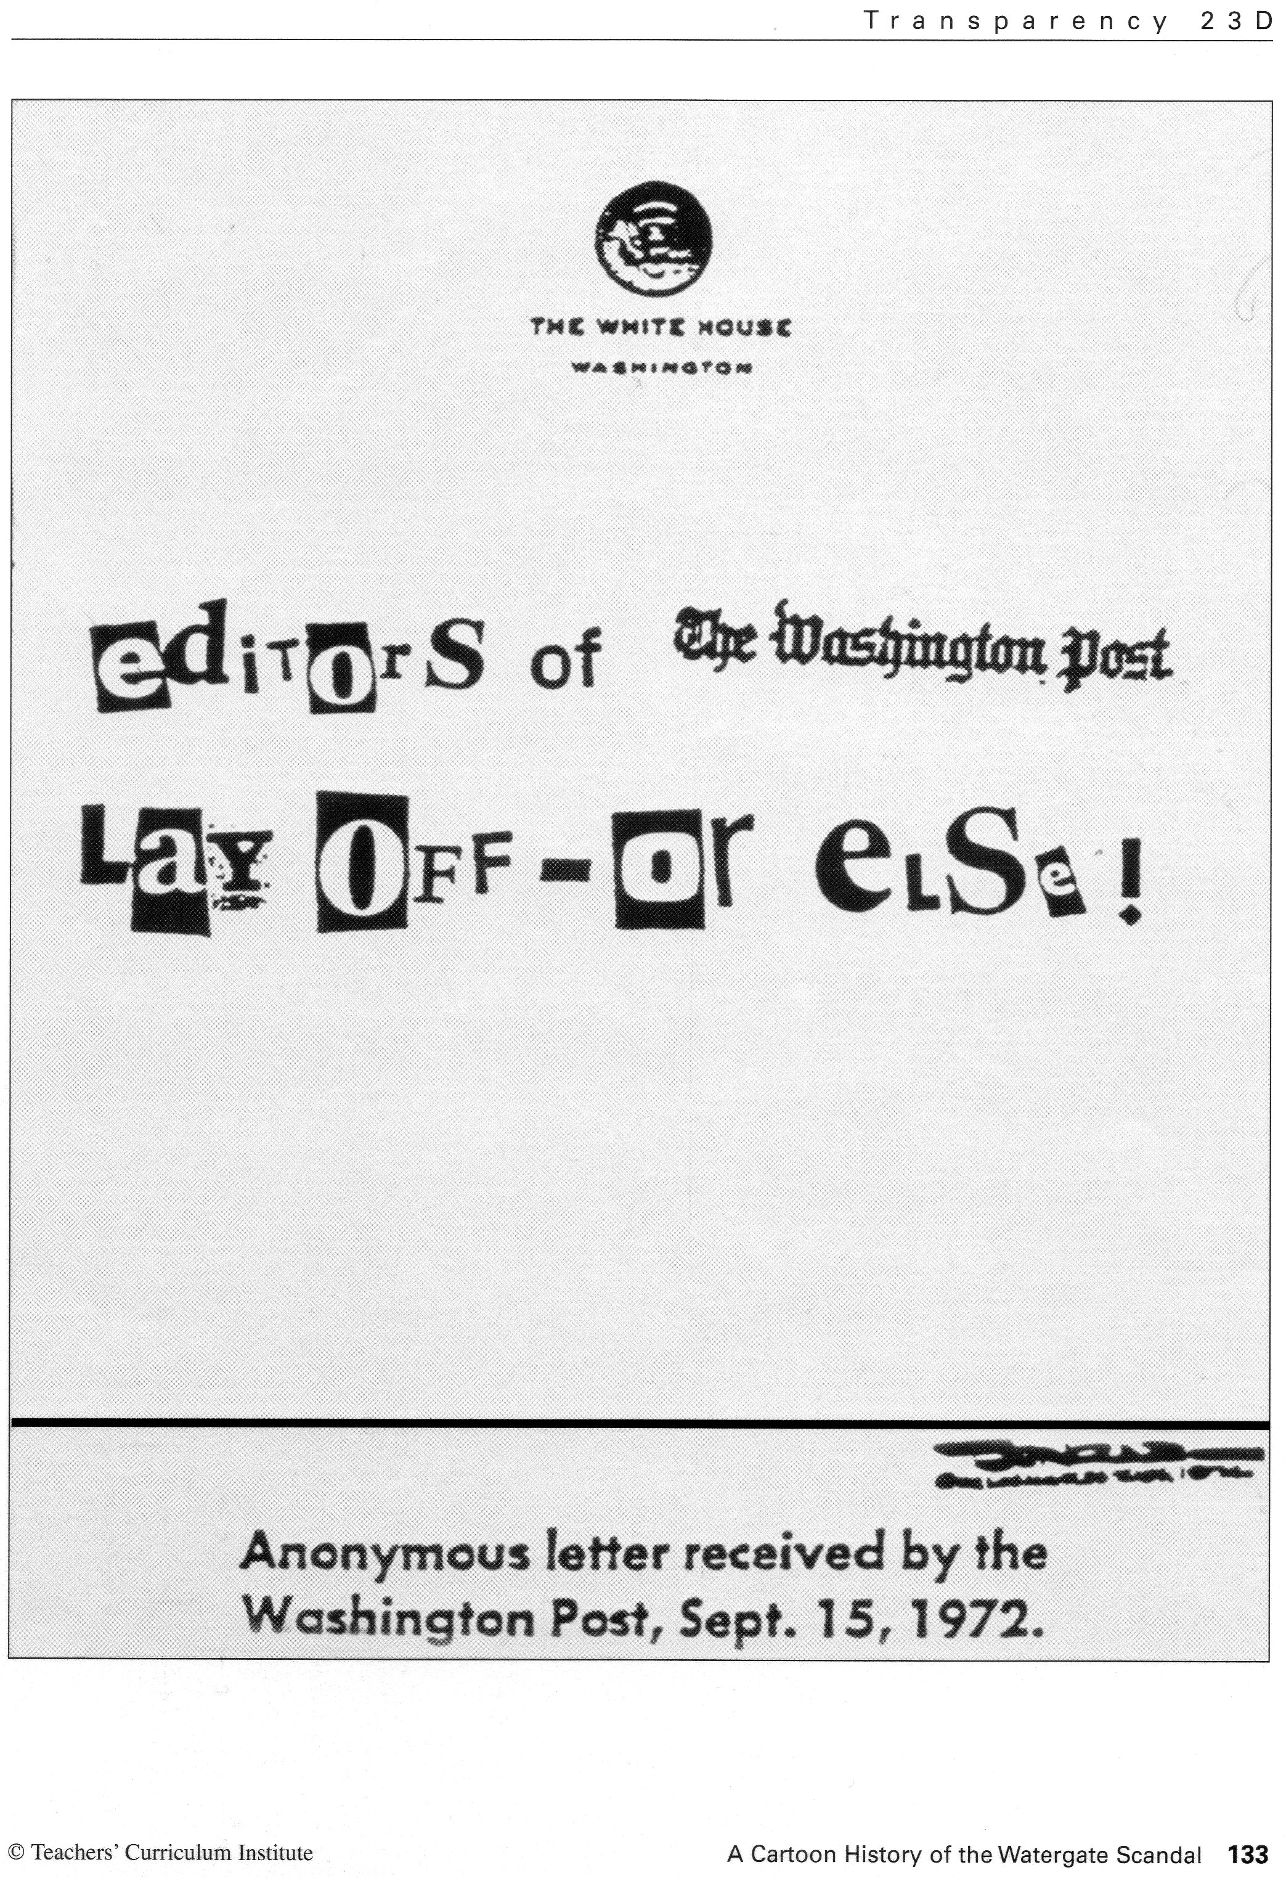

Slide 3
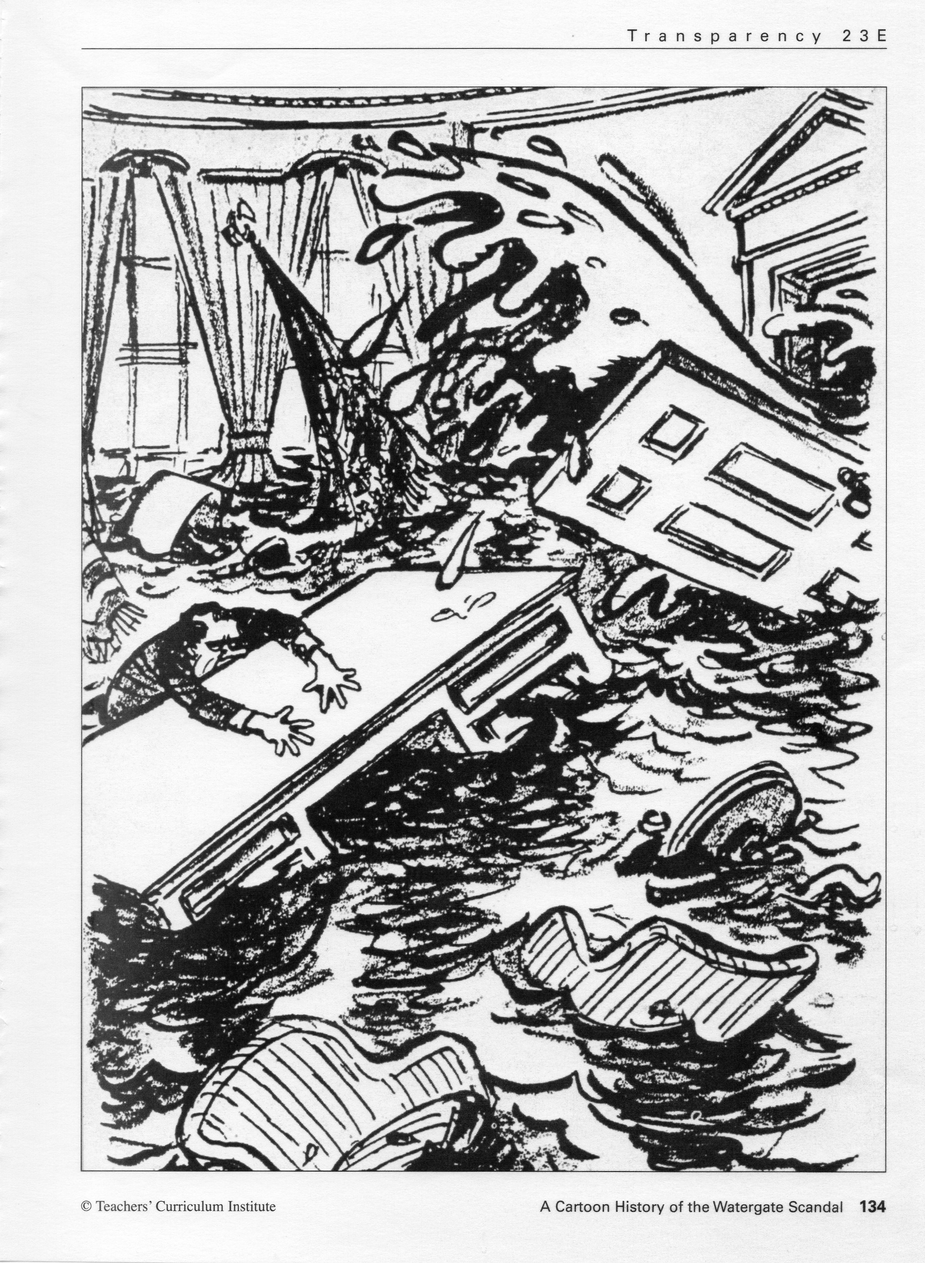

Slide 4
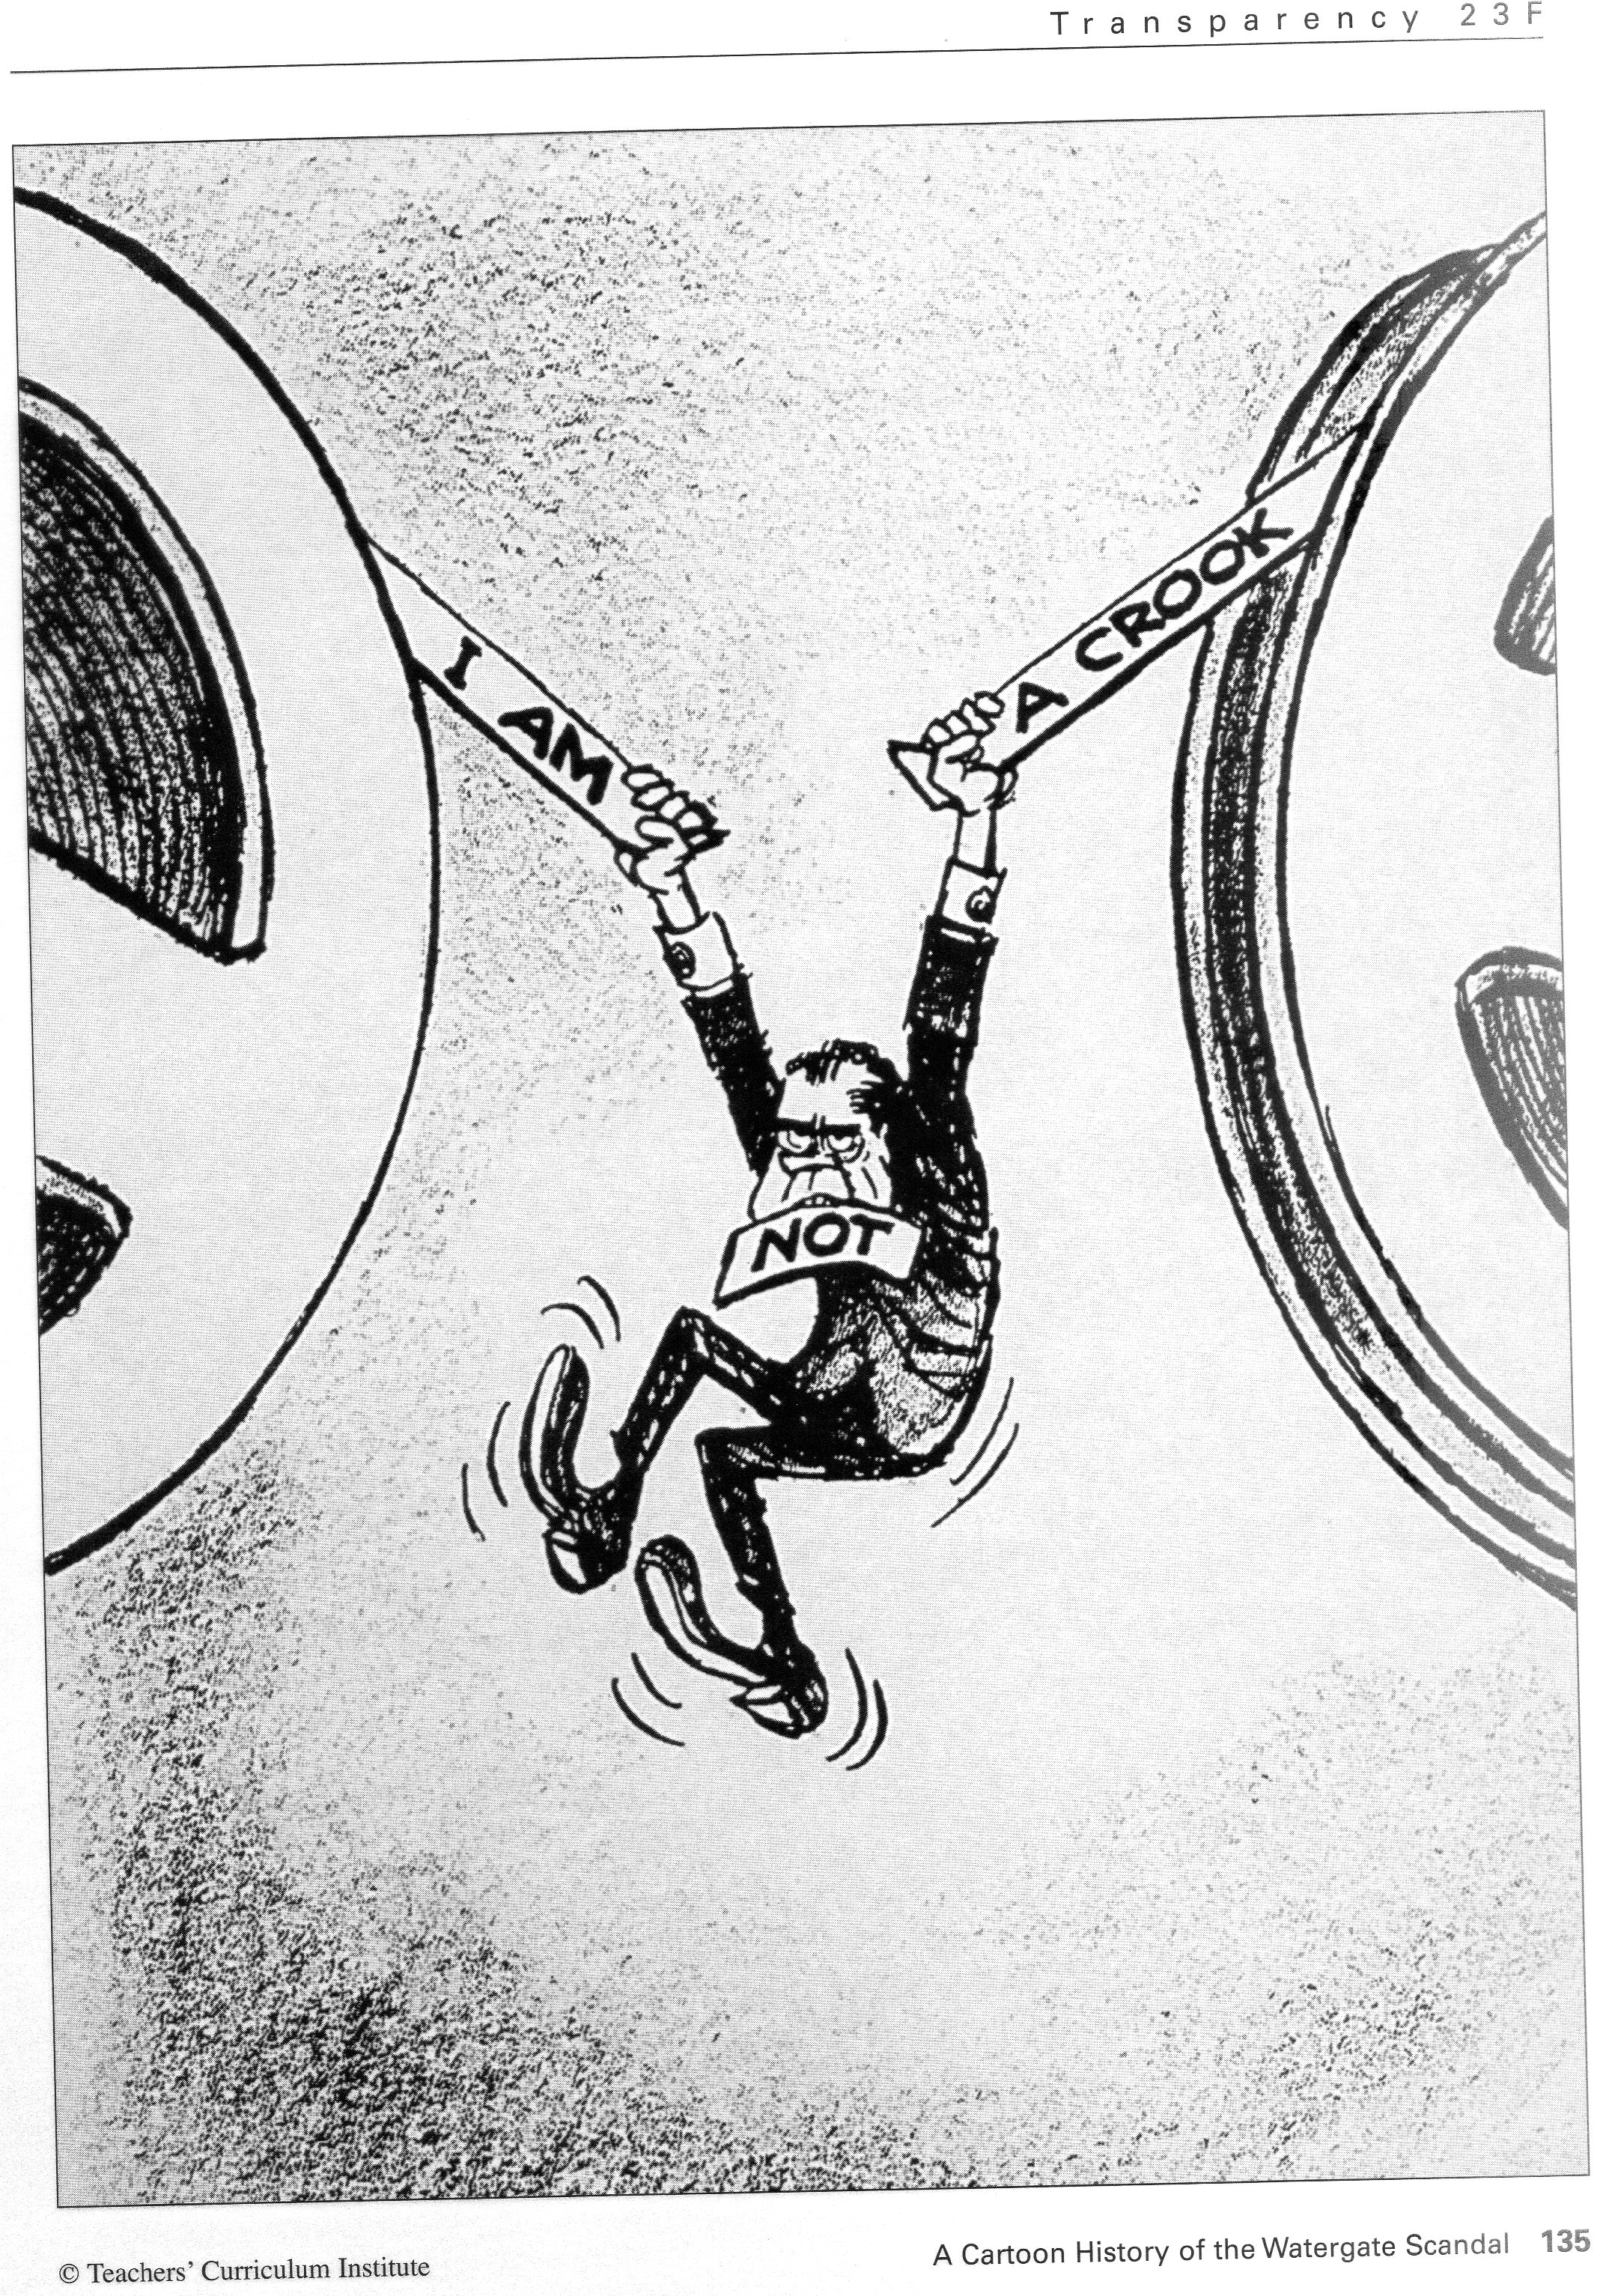

Slide 5
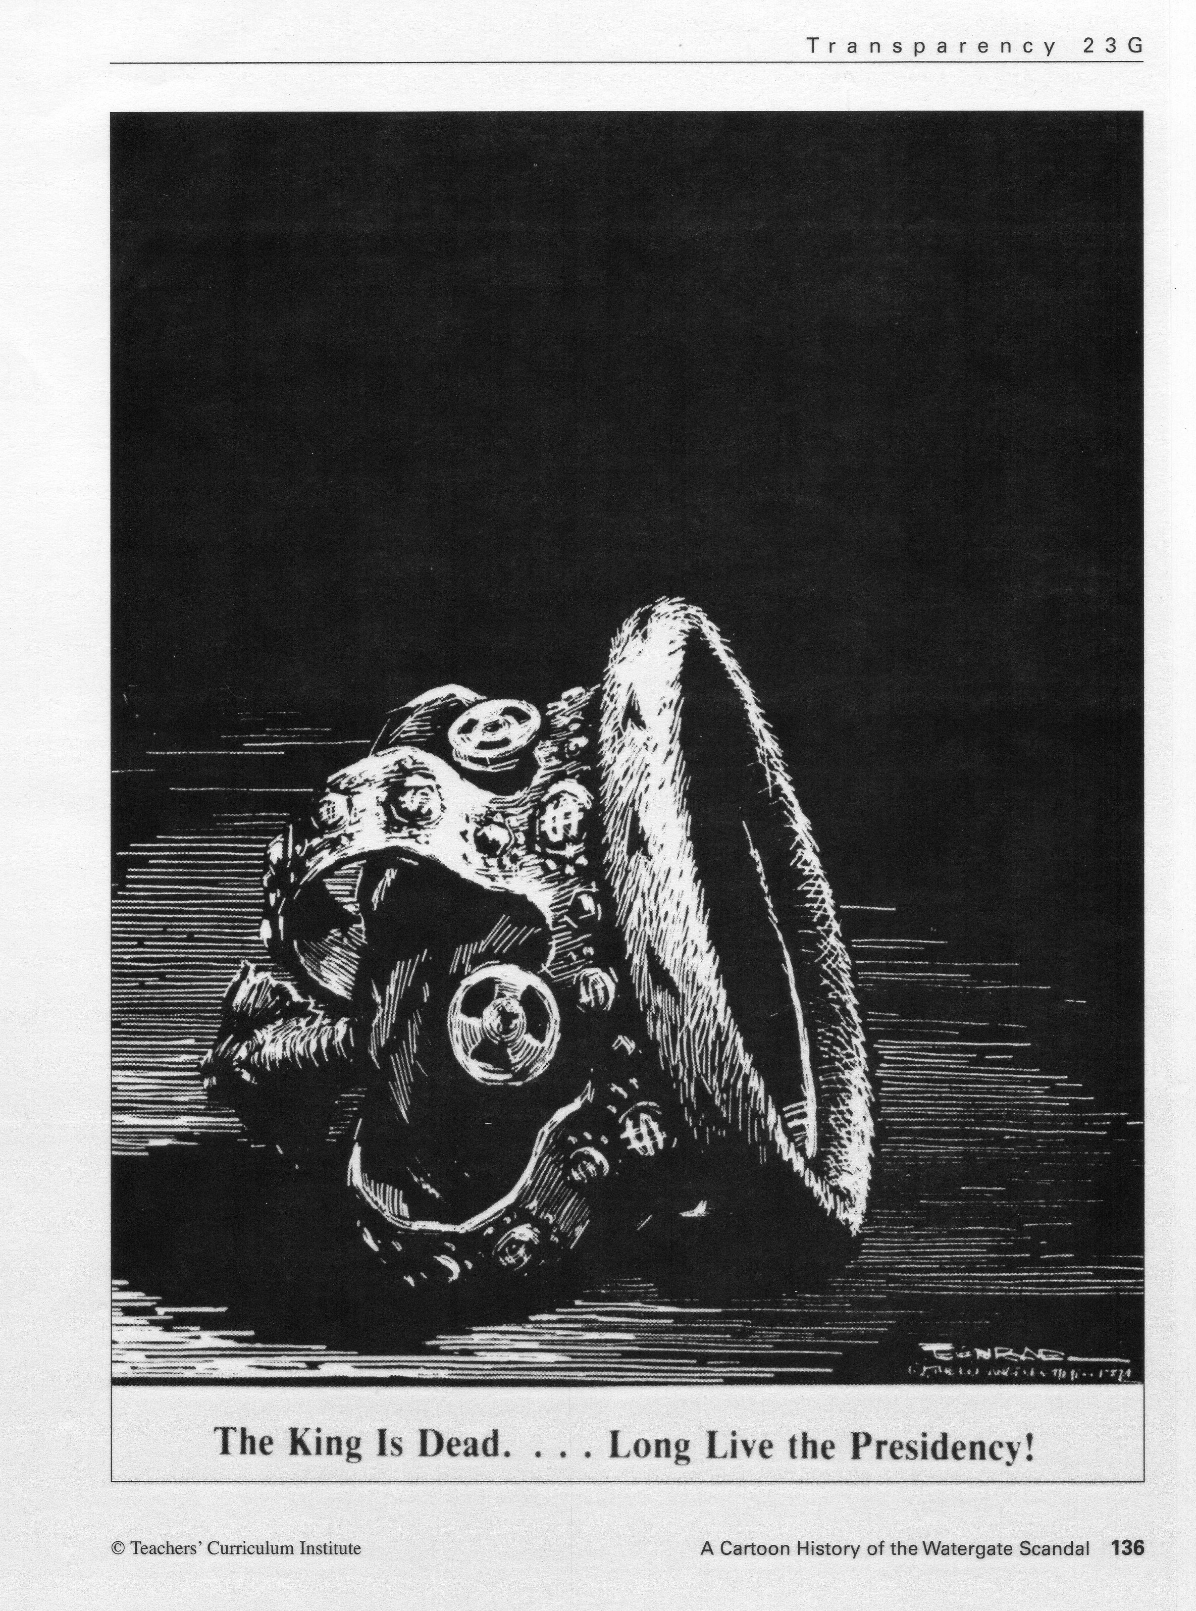

Slide 6
What happened to Nixon’s signature over the course of his term in office? How might Watergate have affected the country?
Aug 9, 1974 – “Those who hate you don’t win unless you hate them, and then you destroy yourself.”
Gerald Ford pardoned Nixon a month later

