Slide 1
Cold War Terms - use an entire sheet of paper to complete
the chart
Term | American Perspective | Soviet Perspective

Slide 2
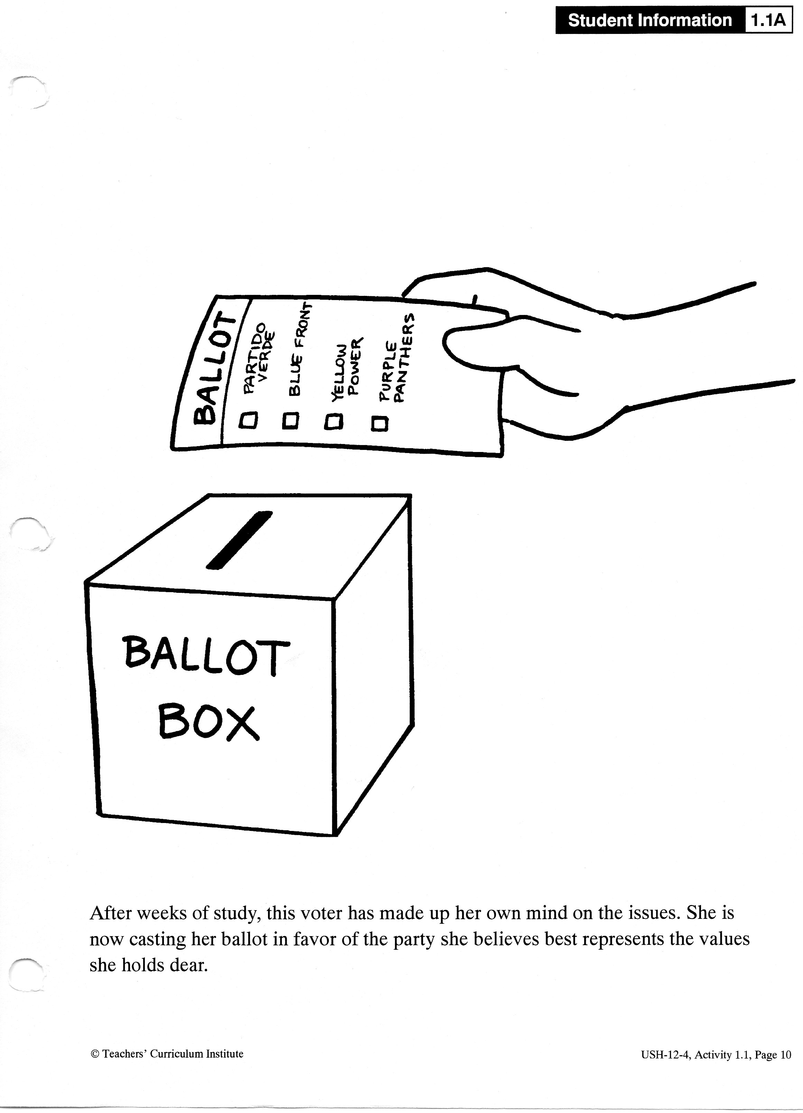

Slide 3
Cold War Terms
Democracy from American Perspective:
It is the best system of government
Democracy from Soviet Perspective:
True democracy can only be secured in an economic system that rewards everyone equally

Slide 4
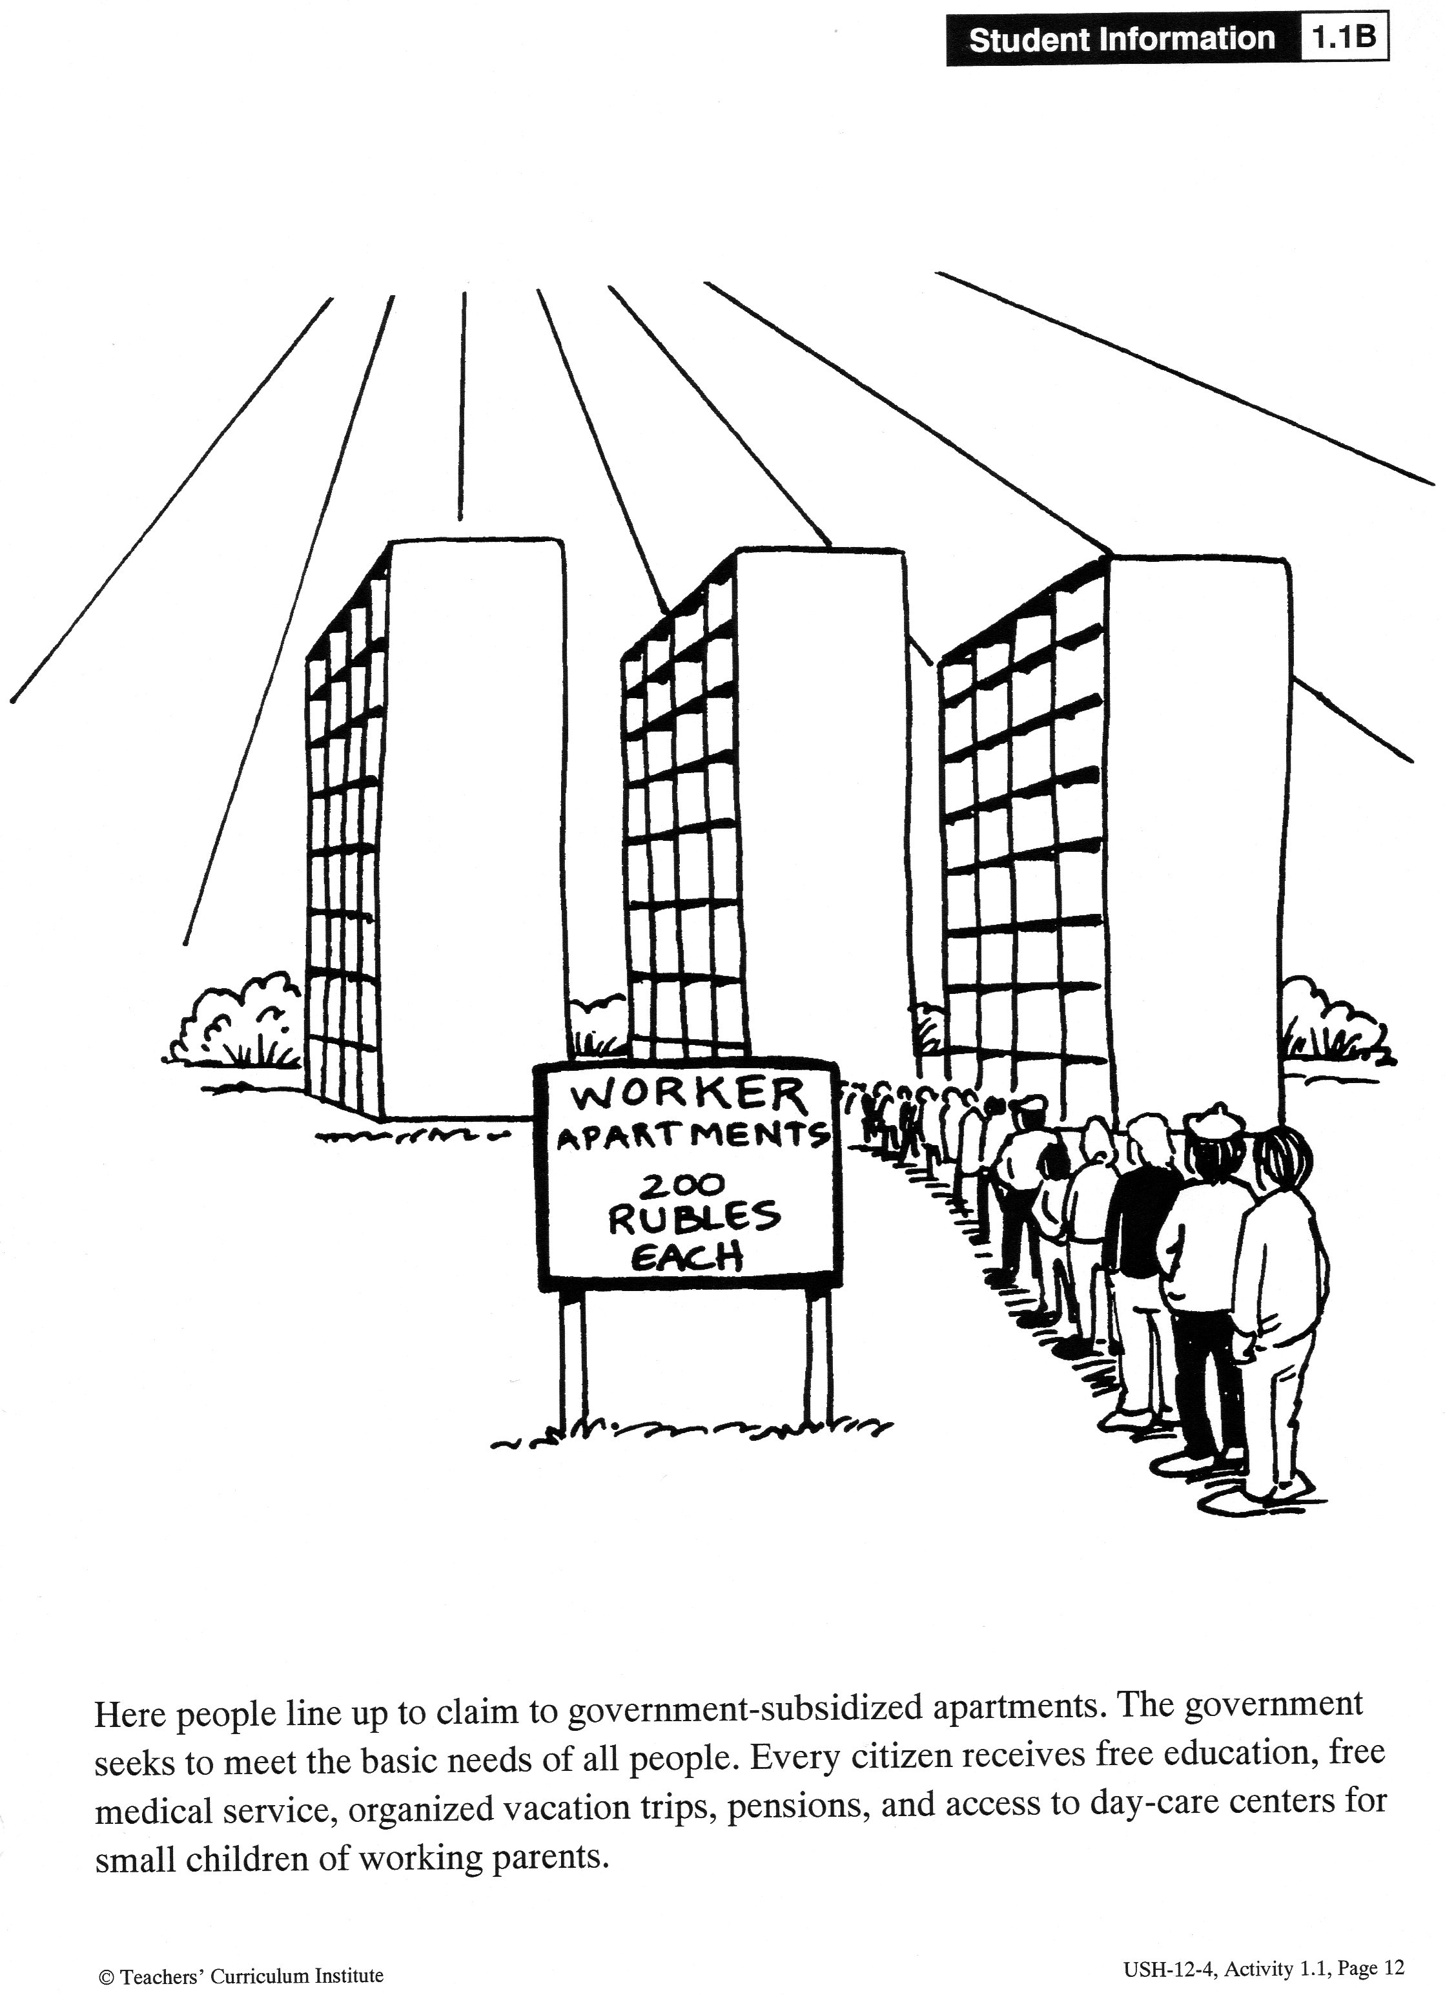

Slide 5
Cold War Terms
Equality from American Perspective:
Equality of opportunity
Equality before the law
Equality from Soviet Perspective:
Equality of condition
Society must share its material wealth

Slide 6
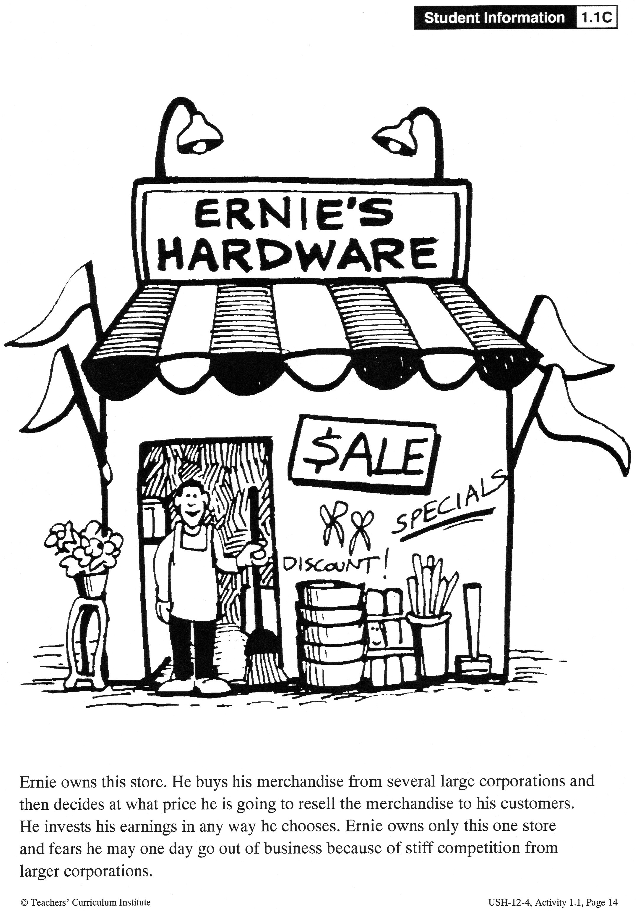

Slide 7
Cold War Terms
Capitalism from American Perspective:
Hard work and individual initiative
Competitive nature results in better products, higher quality of service and brings out the best in people
Capitalism from soviet perspective:
Evil economic system
Breeds selfishness and undermines cooperation and community

Slide 8
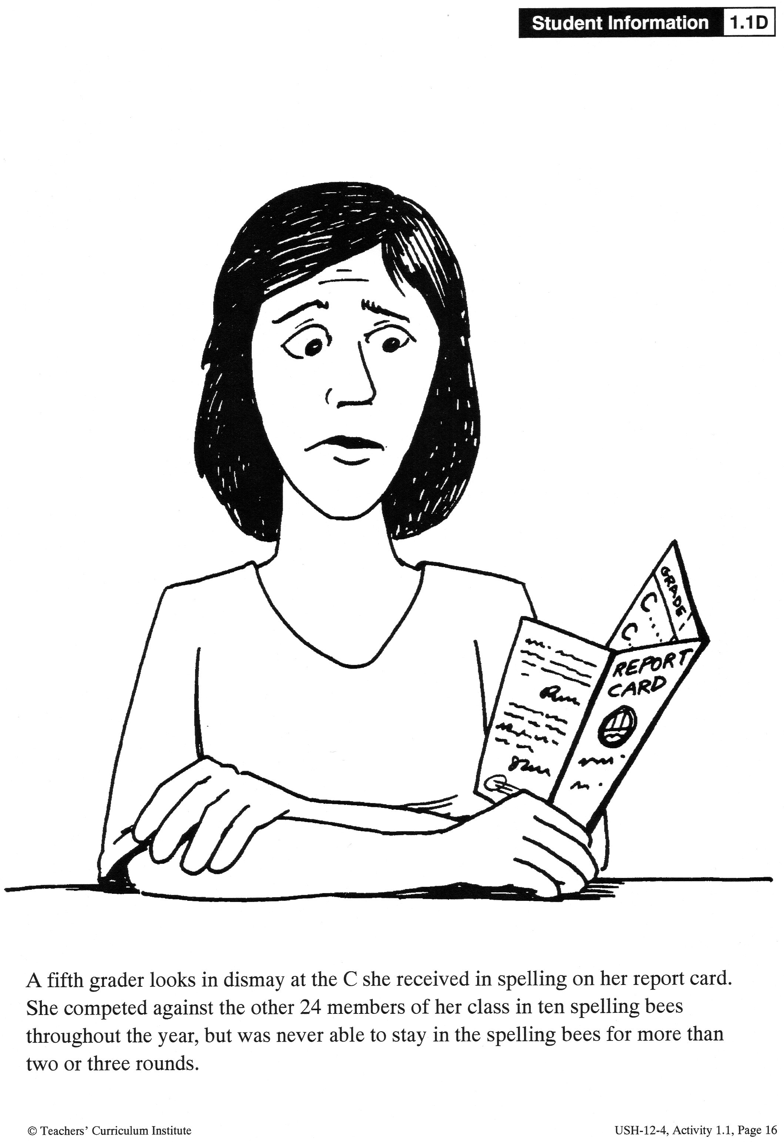

Slide 9
Cold War Terms
Individualism from American Perspective :
All of society benefits if each individual reaches highest possible level of achievement
Human nature is competitive
Individualism from Soviet Perspective:
Argued that it creates a society full of inequality and exploitation where winners take advantage of losers

Slide 10
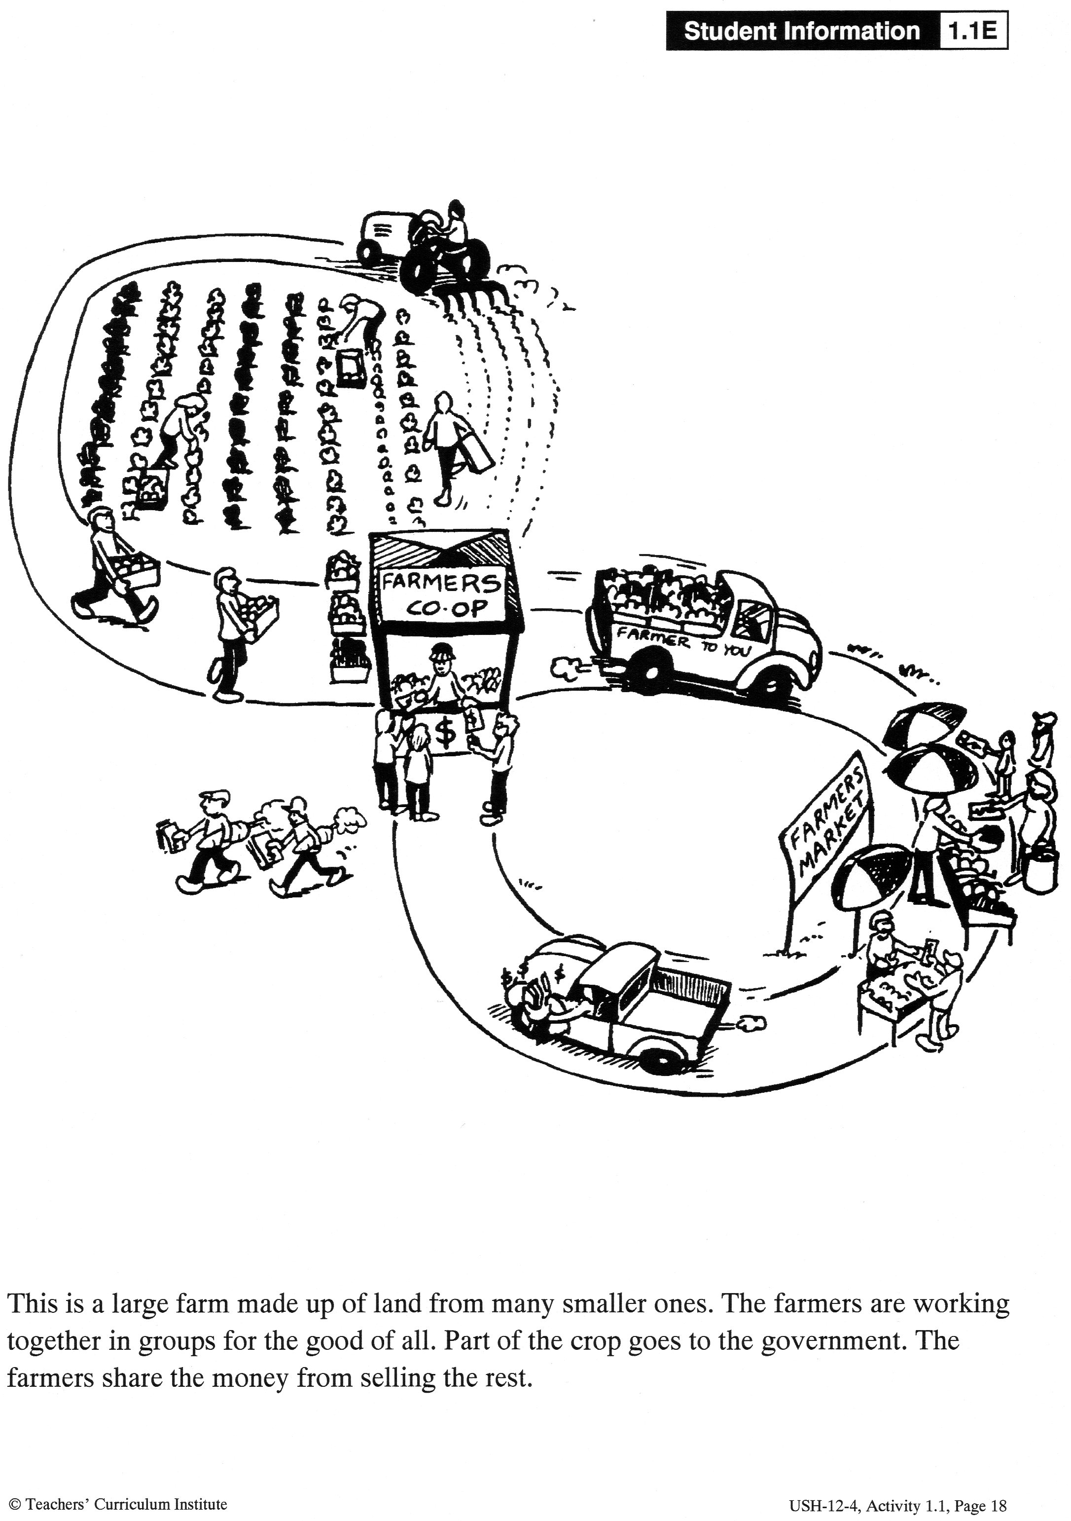

Slide 11
Cold War Terms
Collectivism from American Perspective:
Violates basic human nature
Violated the rights of individuals to own private property
Collectivism from Soviet Perspective:
Cooperation and caring are the finest parts of human nature
Only way to create fairness in society was for everyone to share ownership of all property

Slide 12
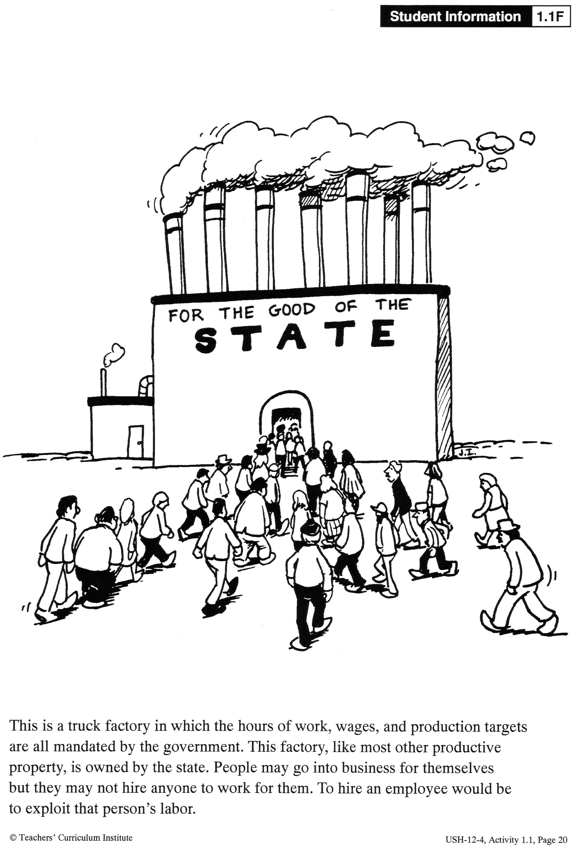

Slide 13
Cold War Terms
Socialism from American Perspective:
Government control over the means of production threatened basic rights – to own and control property
Socialism from Soviet Perspective:
Only shared ownership could prevent the abuses of capitalism and protect common people from exploitation

Slide 14
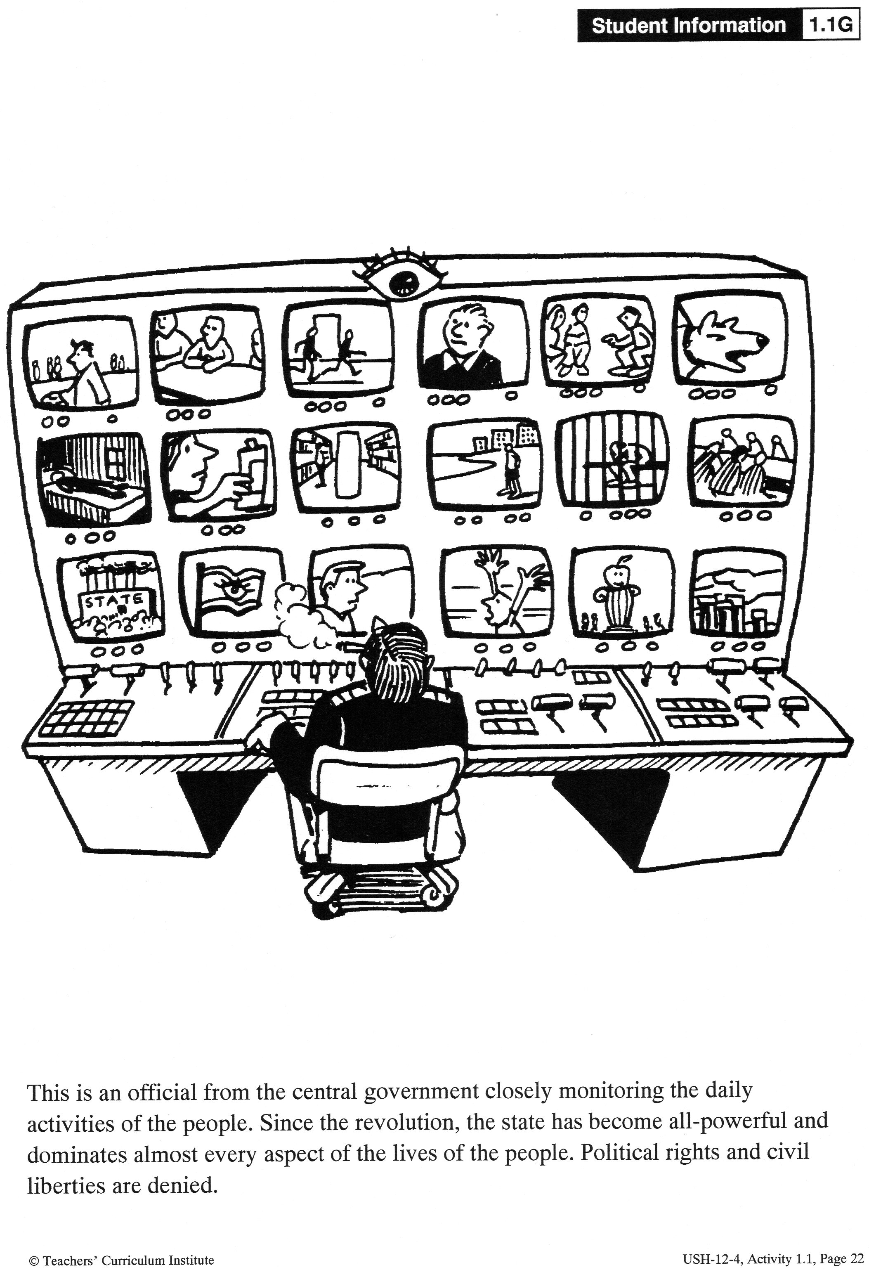

Slide 15
Cold War Terms
Totalitarianism from American Perspective:
Threatened basic human rights – freedom of press, assembly, speech…
Totalitarianism from Soviet Perspective:
Needed to transform society into a truly equal socialist state
People’s selfish desires had to be controlled by government

Slide 16
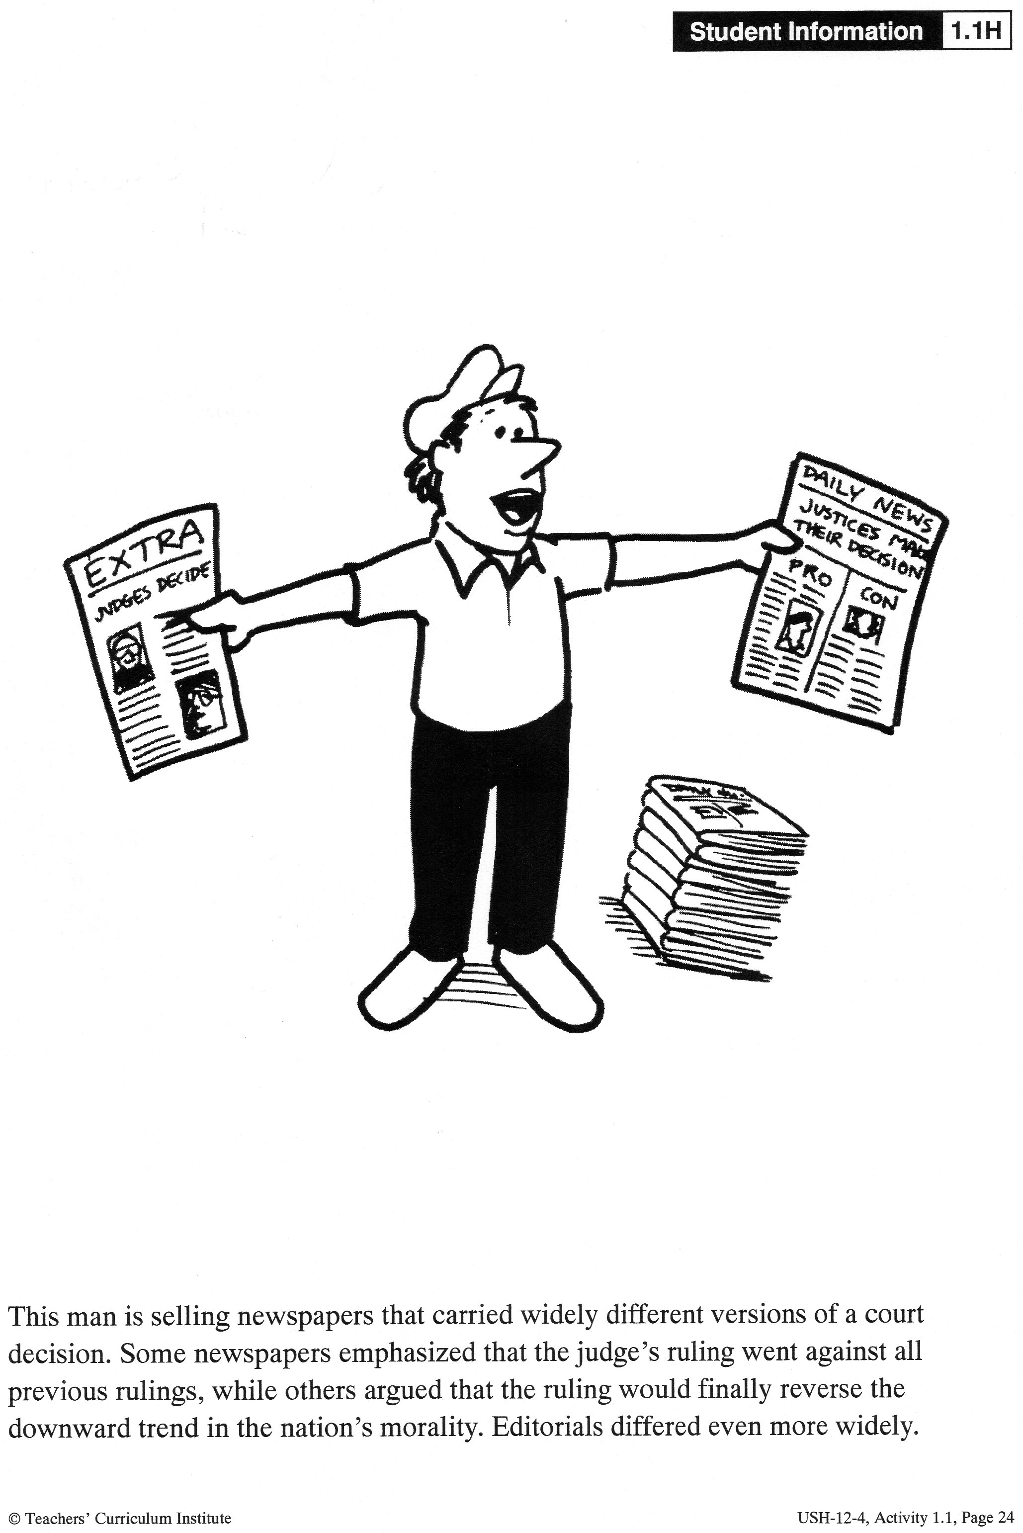

Slide 17
Cold War Terms
Freedom from American Perspective:
Freedom is at the core of a happy and productive society
Freedom from Soviet Perspective:
People are not free unless they have a fair share of wealth that allows them to live beyond basic needs

Slide 18
Process it!
Your job – create TWO billboards promoting four Soviet values and four American values
The billboards should be colorful and visually appealing and use symbols, pictures and a few words or slogans to promote the four values
At the bottom of the billboards create some graffiti that a person from the other country might write in response to seeing the billboard (must be appropriate for school!)

